Slide 1
Land Use, Fiscal Impact Analysis
and City Fiscal Health
Joint Workshop
Sparks City Council &
Sparks Planning Commission
September 23, 2019

Slide 2
Workshop Agenda
Project background and purpose
Consultant (Economic & Planning Systems, Inc.) work program
City of Sparks General and Road Funds overview
Fiscal impact analysis: objective, model, & policy considerations
Long term fiscal health analysis
Discussion and possible action

Slide 3
Project Background and Purpose
Grew out of “Ignite Sparks” Comprehensive Plan
Managing Growth policies require fiscal analysis in conjunction with certain land use applications
Need for consistent approach to evaluating land use proposals and impact on City finances
Develop and adopt standard fiscal impact methodology for applicants to use
Desire to understand long-term implications of Comprehensive Plan Land Use Map and possible changes

Slide 4
Consultant Work Program
City Council approved 2018 contract with Economic and Planning Systems (EPS)
Work program:
Fiscal Impact Methodology
Fiscal Impact Analysis Submittal Guidelines
Long Term Fiscal Health Analysis

Slide 5
Fiscal Impact Analysis Objective
Purpose is to obtain “apples to apples” estimates of costs and revenue impacts to the City from new development.
The analysis compares the estimated revenues generated by new development to estimated costs of public services required to serve new development to determine net fiscal impact.
The analysis separates General and Road Funds, which are directly impacted by development and are not cost recovery funds.

Slide 6
Fiscal Impact Analysis Model
EPS:
Assessed potential effects of different types of development on each departmental budget.
Estimated revenues and costs generated by development based on budgets for the General and Road Funds.
Used specific factors to estimate impacts on the budget that are most directly tied to development.
Applied “average cost factors” to other revenues and expenditures.

Slide 7
City of Sparks General & Road Funds
Nevada tax structure and laws require Nevada cities to rely on new development to sustain fiscal health.
General and Road Funds are the focus of analysis; both are directly impacted by development and growth.
Enterprise Funds (e.g., Development Services and Sewer Funds) are also impacted by development but are generally cost-recovery funds.

Slide 8
General Fund Revenues
Fiscal year 2020 budgeted revenues total $76.8M. Primary revenue sources:
Consolidated Tax Revenue (CTAX) and Fair Share Taxes – $31.5M. (41% of General Fund revenues)
Property Taxes – $24.9M. (32%)
Licenses and permits – $15.3M. (20%)
Together these three revenue sources account for 93% of General Fund revenues.

Slide 9
General Fund Revenues
CTAX and Fair Share Tax revenue are largely sales taxes.
These revenues are impacted by population and employment change within Washoe County.
City receives CTAX Base and Excess distributions.
Excess distribution (20-25% of total) is more directly and immediately impacted by growth.

Slide 10
General Fund Revenues
Property Taxes
Amount received by City depends on value of properties in Sparks but is significantly restricted by tax cap laws.
New development and improvements to previously developed property increase revenue to City.
Depreciation of existing buildings and improvements diminishes revenue from existing development, increasing reliance on new development for property tax revenue.

Slide 11
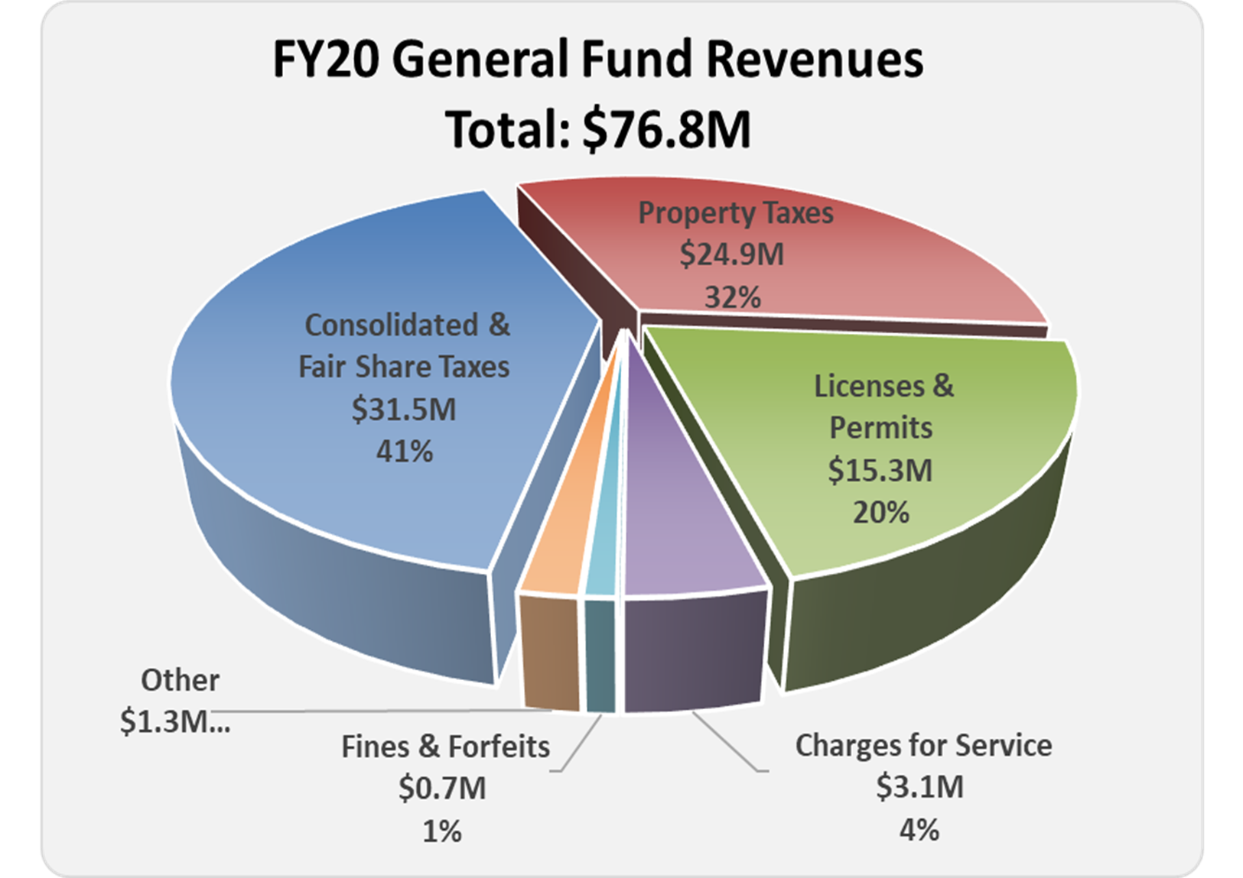

Slide 12
General Fund Expenditures
Fiscal year 2020 budgeted expenditures total $74.6M. Primary categories include:
Salaries and wages - $36.4M. (49%)
Employee benefits - $23.0M. (31%)
Non-discretionary services & supplies - $9.5M. (12%)
Discretionary services & supplies - $5.7M. (8%)

Slide 13
General Fund Expenditures
Fiscal year 2020 budgeted expenditures by Department
Police – $31.6M. (43%)
Fire – $19.0M. (25%)
Community Services – $8.1M. (11%)
Management Services – $7.0M. (9%)
Other – $8.9M. (12%)
Police and Fire Departments represent 68% of total.

Slide 14
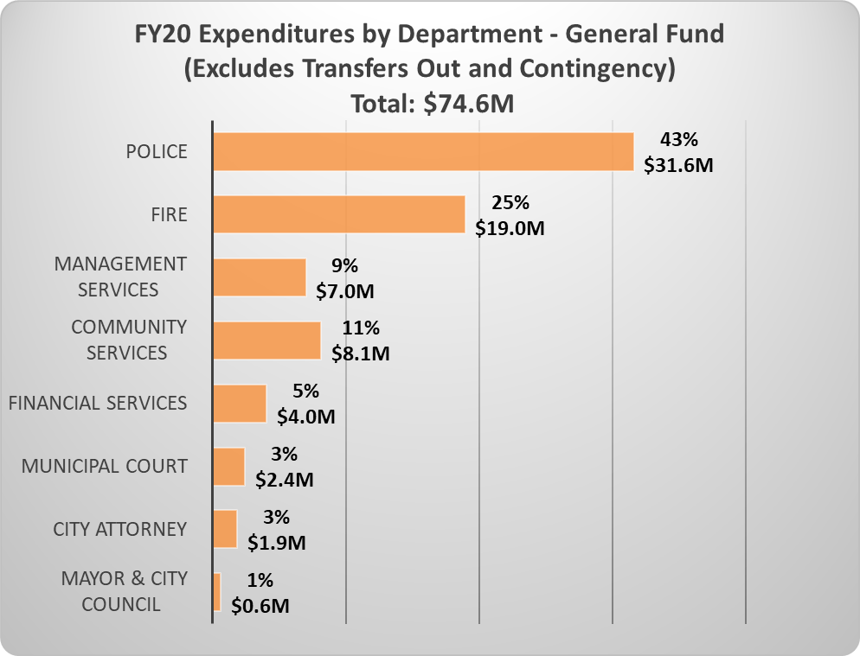
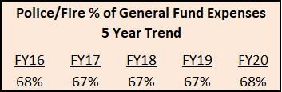

Slide 15
General Fund Expenses
Development has significant fiscal impacts on General Fund public safety services.
Impact on Police services is based on calls for service generated by development
Impact on Fire and emergency medical response services are categorized by service areas and is based on response time and distance from a fire station
Development located in areas not meeting response time standard increases City public safety costs – such as, additional fire stations (e.g., Station 6).

Slide 16
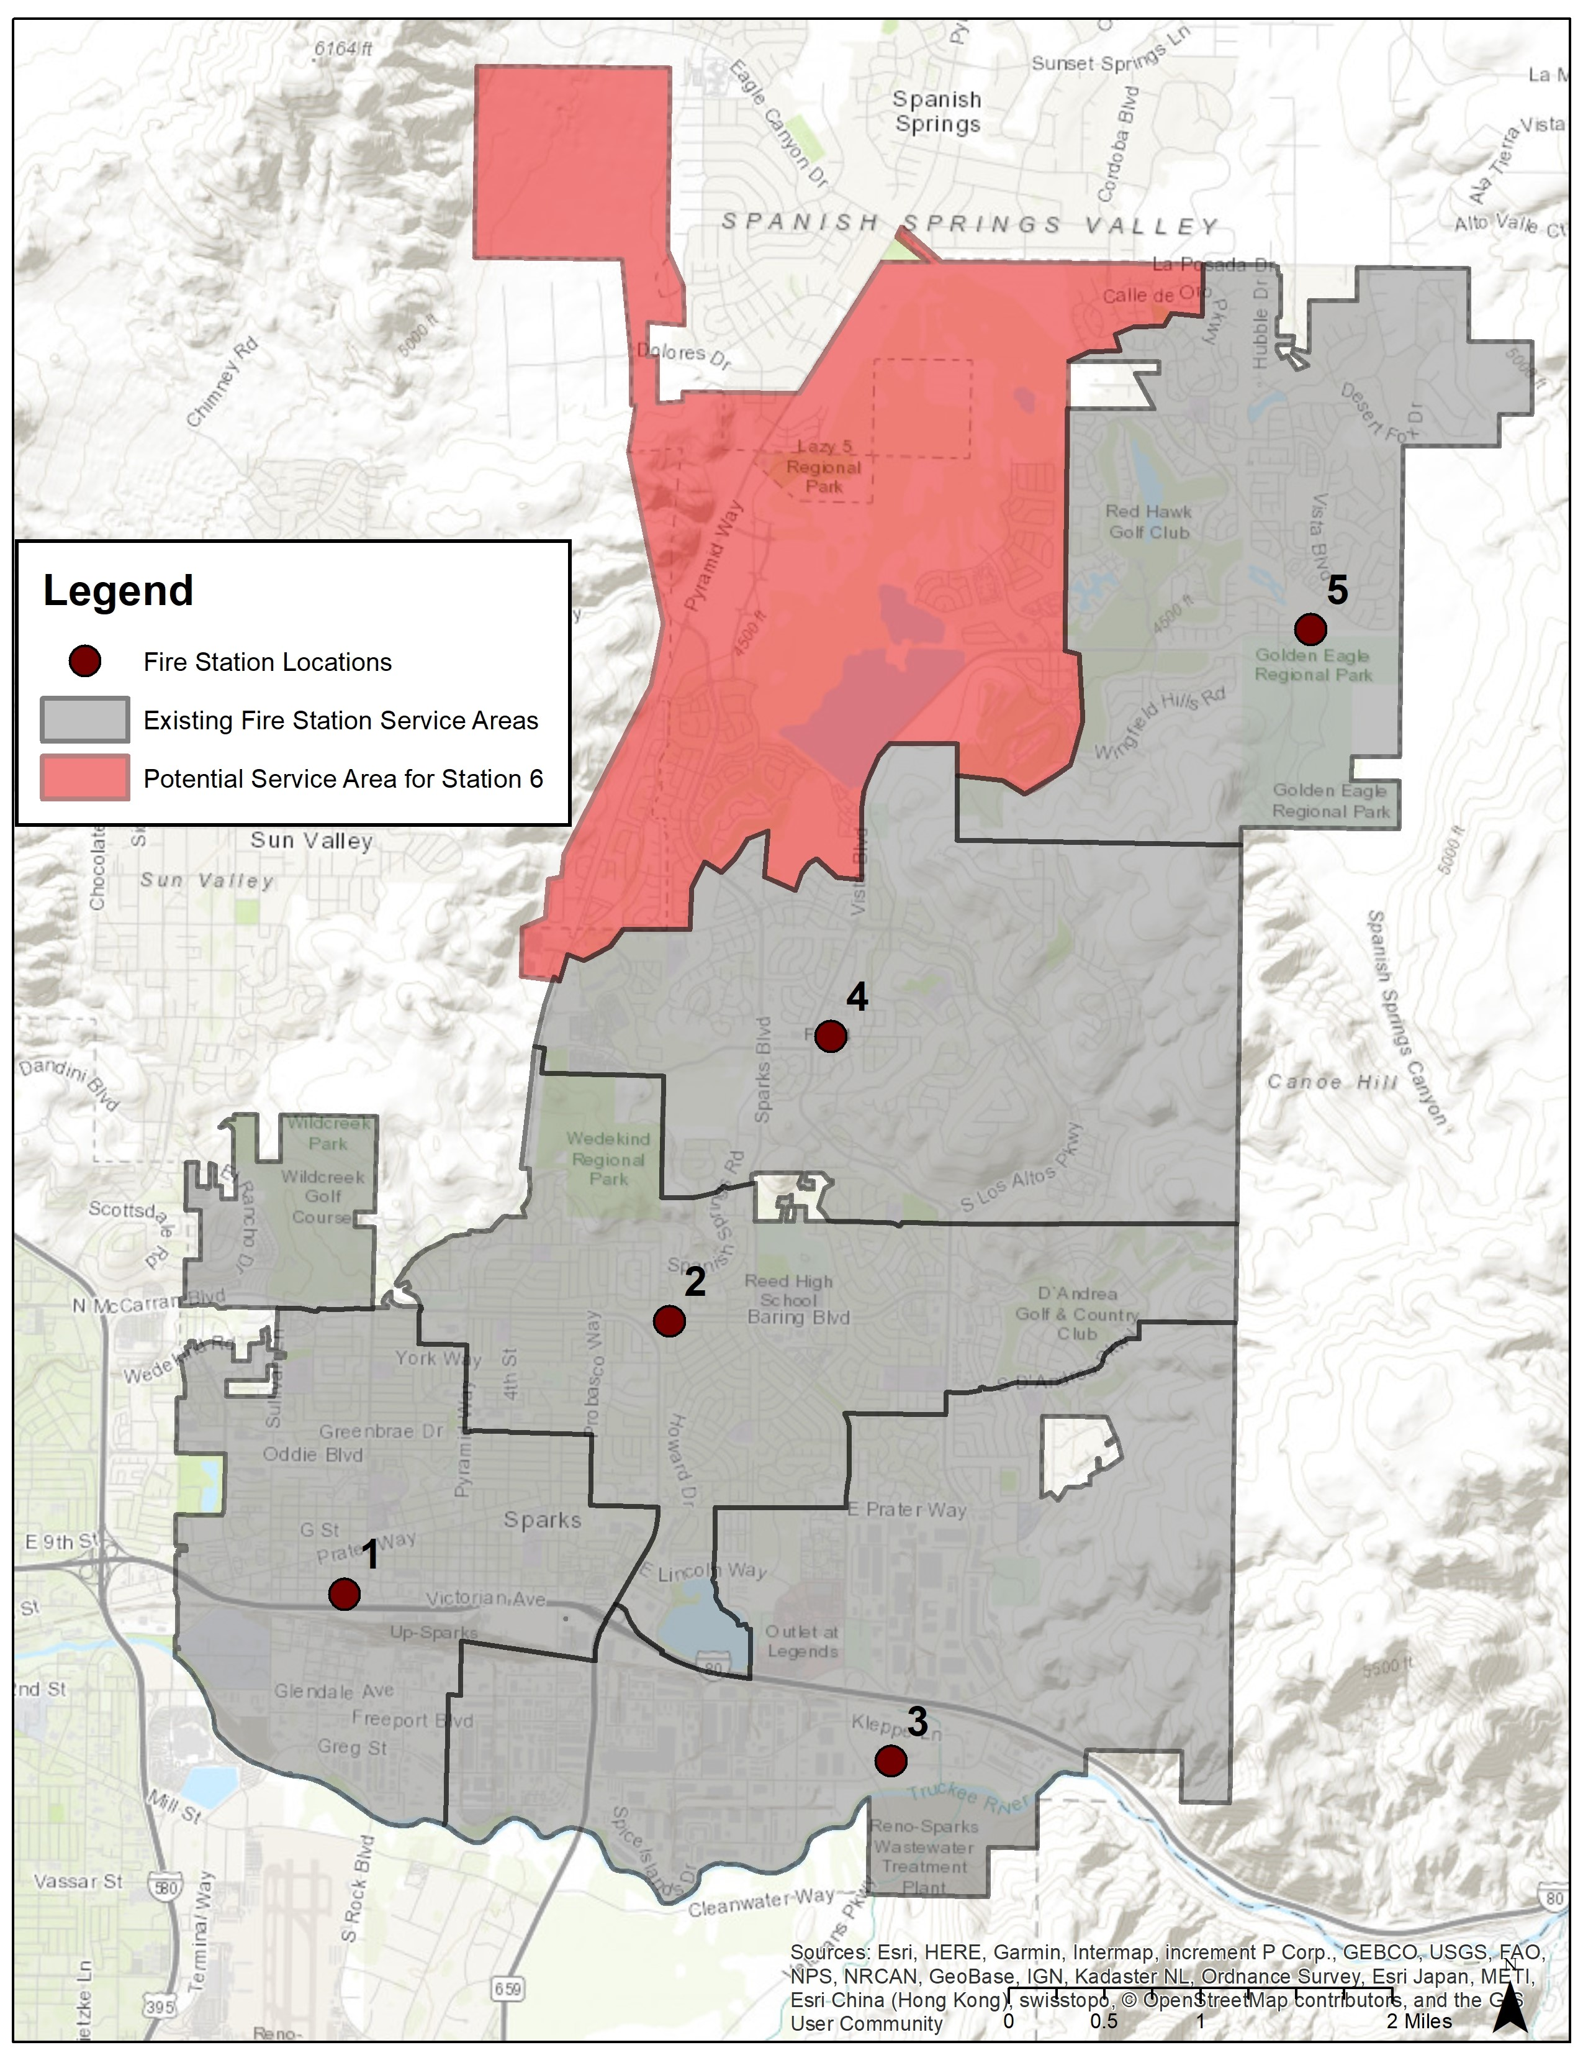
Fire Station Service Areas

Slide 17
Road Fund Revenues
Purpose is to provide for maintenance, repair, acquisition, and construction of roads and streets.
Fiscal year 2020 budgeted revenues total $5.9M. Primary revenue sources include:
Fuel taxes – $2.8M. (47% of Road Fund revenues)
Electric franchise fees. – $1.6M (27%)
TMWA right of way fees. – $0.7M (12%)
Gas franchise fees – $0.5M. (8%)

Slide 18
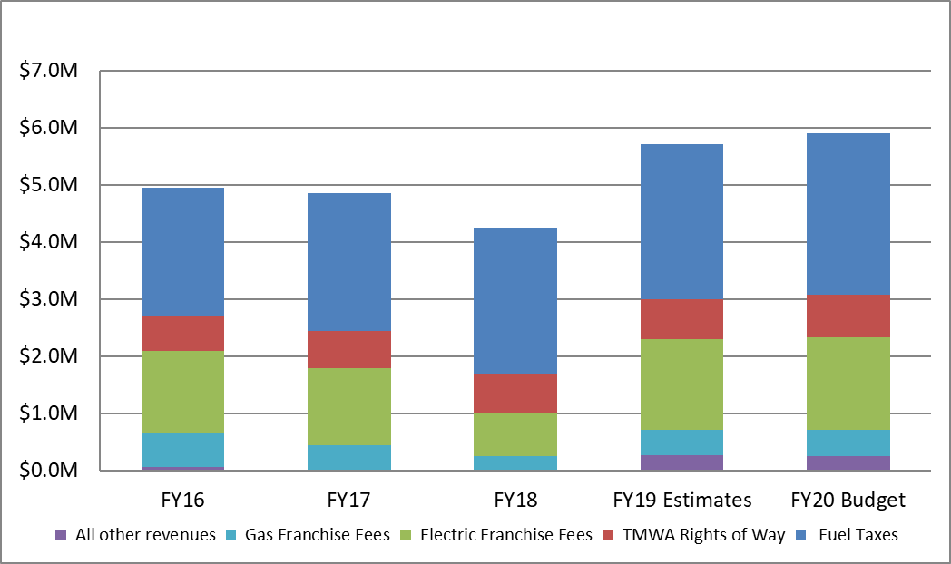
Revenues, Road Fund, Fiscal Years 2016 to 2020

Slide 19
Road Fund Expenses
Fiscal year 2020 budgeted expenses total $6.1M. Primary categories include:
Capital improvements – $2.2M. (36%)
Salaries and benefits – $2.0M. (33%)
Services and supplies – $1.9M. (31%)

Slide 20
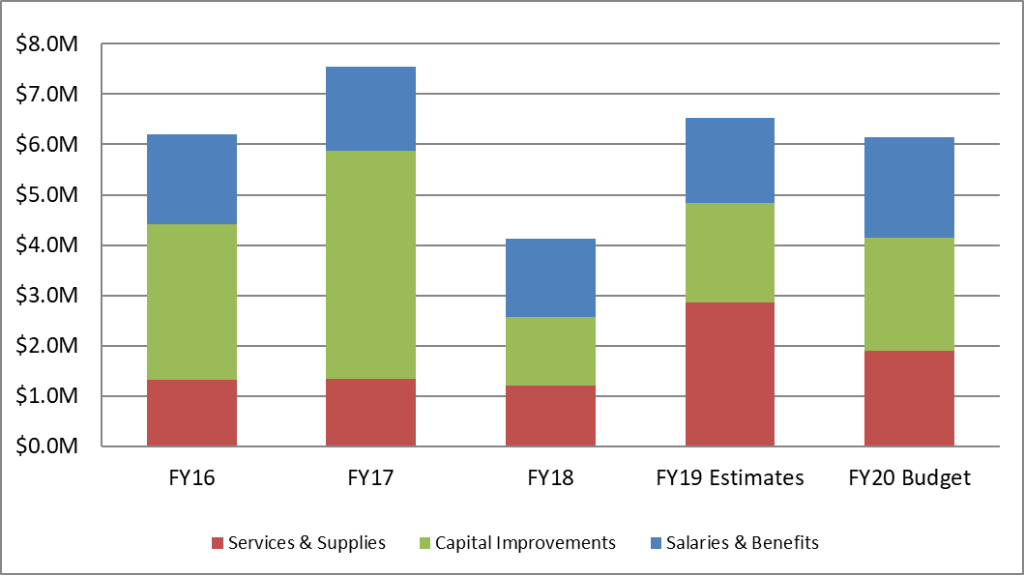
Expenses, Road Fund, Fiscal Years 2016 to 2020

Slide 21
Road Fund Expenses
New development produces more facilities and infrastructure for the City to maintain, including roads, sanitary sewer lines, drainage facilities, trails, and parks.
Road maintenance requires the largest expenditures and is not a cost recovery (i.e., Enterprise) fund.
Sparks fleet and road maintenance yards are in southwest corner of the City.
Development within the McCarran/Sparks Blvd loop is the least expensive to serve; costs increase the further development is located from the maintenance yard.

Slide 22
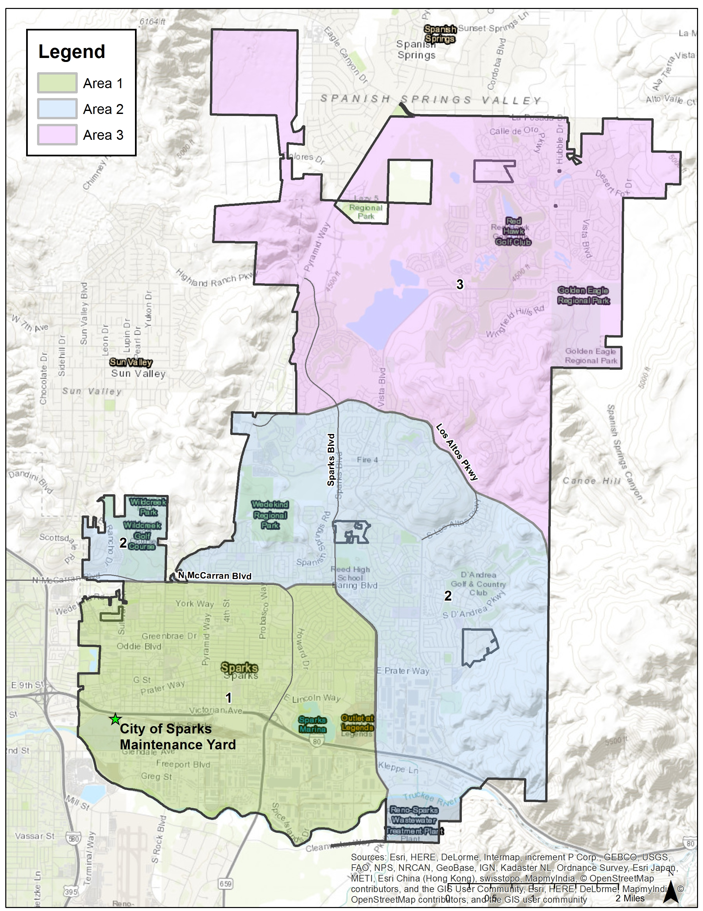
Road Fund
Service Areas
The farther from the yard, the more travel time and cost to transport staff and materials.
Approximate distance and travel time to:
E Prater / N. McCarran – 3.2 miles / 9 minutes
Vista / Geno Martini Pkwy – 6.4 miles / 15 minutes
Van Gorder Elementary – 11.6 miles / 25 minutes

Slide 23
Fiscal Impact Analysis Model Summary Guidelines
Required Model Inputs:
  Project size (land acres to be developed)
  Proposed land uses and type of development
  Market value and development absorption
  Use of a 20-year time frame
  Standardized formulas for developer to estimate City revenues and service costs related to the proposed development

Slide 24
Fiscal Impact Analysis Policy Considerations
The resulting Fiscal Impact Analysis Guidelines are intended for use by parties submitting applications for:
Comprehensive Plan land use amendments for sites over 5 acres (per Policy MG5)
Annexations (per Policy MG7)
City’s Sphere of Influence expansions (Policy MG8)
Land use approvals for greenfield sites 20 or more acres in size (Policy EV10)

Slide 25
Fiscal Impact Analysis Policy Considerations
Some caveats:
Fiscal balance and health cannot be achieved on a project by project basis.
Some projects will generate a net negative impact, others a positive impact.
Approval or denial of a development proposal solely on the basis of fiscal impact can be problematic.

Slide 26
Questions?

Slide 27
Long Term Fiscal Health Analysis - Intro
Purpose – address the following questions:
How will build-out of Sparks, based on the uses adopted in the City’s Comprehensive Plan, impact the City’s long-term fiscal health?
How would changes to the Comprehensive Plan erode or improve fiscal health?
What guidance can the analysis provide to City staff, the Planning Commission and the City Council regarding land use entitlement requests?

Slide 28
Long Term Fiscal Health Analysis - Intro
The analysis includes:
Estimated future development demand in Sparks;
Estimated land capacity for new development in Sparks, by type of land use, which is compared to the estimated demand;
The fiscal impact of forecasted growth and development demand over a 20-year period; and
Alternative growth scenarios to illustrate how land use decisions impact long term fiscal health.

Slide 29
Population, Employment and Development Trends

Slide 30
Population
Population and household growth since 2010. Sparks:
Grew slower than in two preceding decades.
Added 10,946 new residents and 3,511 households.
Captured 26% of Washoe County population growth.

Slide 31
Change in Population, Sparks, 1990 to 2018

Slide 32
Change in Number of Households, Sparks, 1990 to 2018

Slide 33
Employment
Employment
2018 MSA* employment = 254,600
(*Reno-Sparks Metropolitan Statistical Area comprised of Washoe and Storey Counties)
Employment tremendously impacted by Great Recession (16% decline between 2006 and 2011).
Annual job growth rate since 2010 of 3.1% is similar to rate in 1990’s of 3.2%.

Slide 34
Reno-Sparks MSA Employment, 1990 to 2018

Slide 35
Reno-Sparks MSA Employment Growth, 1990 to 2018

Slide 36
Employment
Washoe County employment growth driven by construction, distribution and warehousing, and administrative sectors.
Construction employment has grown the most since 2010, adding 7,307 jobs after losing over 14,700 jobs from 2006 to 2010.
Transportation and warehousing and administrative services industries collectively added over 10,000 jobs since 2010 (1/3 of total employment growth).
Administrative services includes back office uses, call centers, and temporary worker providers.

Slide 37
Employment
Tourism and service industries (accommodations and food service, retail trade, and health care) have added nearly 10,000 jobs since 2010 (another 1/3 of employment growth).
Manufacturing and professional services also grew significantly, adding 2,385 and 1,820 jobs respectively, since 2010.

Slide 38
Washoe County Employment Change by Industry 2010 to 2017

Slide 39
Storey County Employment Change by Industry 2010 to 2017

Slide 40
Housing Development
City permitted 5,270 residential units – an average of 586 per year – during 2010-2018 period:
Single-family – 3,169 units (352/year)
Multi-family – 2,080 units (231/year)
Other – 21 units (2/year)
Big uptick in 2017 – 1,664 units, of which 1,136 were multi-family.

Slide 41
Non-Residential Development - Office
Sparks has office inventory of 1.32M square feet, which accounts for 8% of MSA’s inventory of 16.3M square feet.
Sparks has only added 3,000 square feet of office since 2010; MSA has added 214,057 square feet.

Slide 42
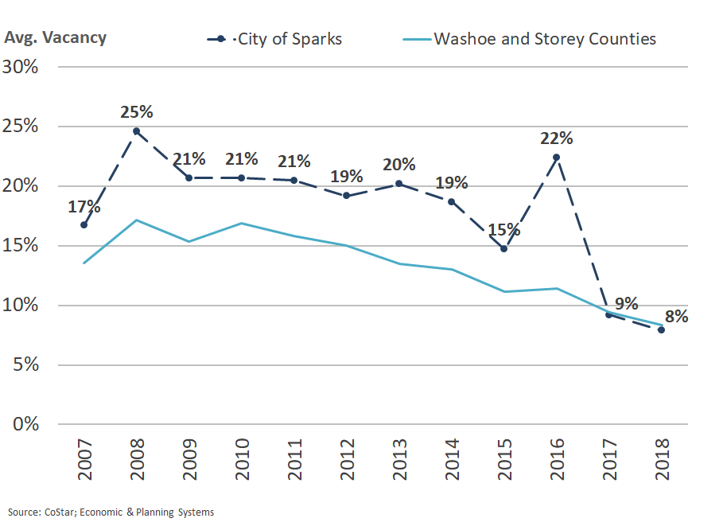
Regional Office Vacancy, 2007 to 2018

Slide 43
Non-Residential Development - Industrial
Industrial space can be used for a warehouse or logistics use, manufacturing, offices or can even be all of these (think former Cityworks site).
Sparks has 28.5M square feet of industrial space, 31% of MSA’s total of 91.6M square feet.
Industrial development has dominated the region’s commercial real estate market since 2010.
Sparks added 1.7M square feet of industrial space between 2010 and 2018, 11% of MSA increase.

Slide 44
Sparks Industrial Inventory, 2007 to 2018

Slide 45
Regional Industrial Vacancy Rates, 2007 to 2018

Slide 46
Non-Residential Development - Retail
Sparks has 6.1M square feet of retail space, which accounts for 24% of MSA’s total of 25.9M square feet.
Sparks added 104K square feet of retail space between 2010 and 2018, 19% of regional increase of 547K square feet.

Slide 47
Regional Retail Vacancy Rates, 2007 to 2018

Slide 48
Forecasts
Population and Land Demand for Housing
Employment and Land Demand for Non-Residential Development

Slide 49
Forecast - Population
Truckee Meadows Regional Planning Agency (TMRPA) Consensus Forecast for period through 2038:
Washoe County forecast to grow by 106,823 residents (1% a year) to 558,746.
Sparks forecast to add 23,180 residents (1% a year) to 120,108.

Slide 50
Forecast – Housing Demand for Land
Methodology:
TMRPA 2016 Housing Study defines 5 types of housing. EPS forecast demand for Sparks, by type, based on building permit trends.
Density ranges for each housing type in TMRPA study used by EPS to translate housing unit demand to land demand for each housing type.

Slide 51
Residential Demand by Type, Sparks, 2017 to 2038
Housing Type # of Units # of Acres
Low-Density Single Family (SF) 244 163
(1.5 DU/Acre)
Moderate-Density SF (4.5 DU/Acre) 5,490 1,220
High-Density SF / 3,050 305
Low-Density Multi-Family (MF)
(10 DU/Acre)
Moderate Density MF (25 DU/Acre) 2,440 98
High-Density MF (50 DU/Acre) 976 20
Totals 12,200 1,805

Slide 52
Forecast – Non-Residential Development
Methodology:
TMRPA, State Demographer, and private 3rd party forecasts used to project overall and industry-specific employment growth in Reno-Sparks MSA.
Basis is Consensus Forecast that Washoe County will add 94,333 “establishment based” jobs (1.4% a year).
Estimated 75K jobs will generate demand for new buildings in region by 2038

Slide 53
Forecast – Non-Residential Development
Next, EPS:
Projected employment by industry from 2018 – 2038.
Aggregated jobs by industry to the three categories of office, industrial and retail uses.
Applied square feet by employee and floor area ratio factors to convert employment forecast to demand for new building space and land.

Slide 54
Forecast – Non-Residential Development
EPS then took their regional forecasts and estimated:
Capture rates for Sparks of regional office, industrial and retail development.
Amount of building space and land, by type, forecast to be developed in Sparks.

Slide 55
Non-Residential Demand
by Type of Use
Sparks, 2018 to 2038
Type of Non-Residential Use Square Feet # of Acres
Office 402,337 31
Industrial 7,112,479 816
Retail 1,556,436 114
Totals 9,071,252 961

Slide 56
Sparks Non-Residential Development Capture Rates
2018 to 2038
Existing Space - Square Feet* Sparks
Type of Use Washoe & Storey Sparks Capture Rates
Office 16,277,730 1,319,583 10%
Industrial 90,996,937 28,507,860 30%
Retail 25,885,180 6,093,398 25%
Totals 133,159,847 35,920,841 25%
* Square footage figures are for the 4th quarter of 2018; source is CoStar.

Slide 57
Demand Versus Capacity of Land

Slide 58
Demand Versus Capacity of Land
Sparks has sufficient land to accommodate forecasted growth in aggregate.
Residential demand forecast is for 1,805 acres; 2,502 acres available.
Non-residential demand forecast is for 961 acres; 1,345 acres are available.

Slide 59
Demand Versus Capacity of Land
There are two sub-categories where demand is projected to exceed land capacity:
Moderate density single family residential – forecasted demand is for 1,220 acres while there are 939 acres of capacity.
Industrial – forecasted demand is for 7.1M square feet while there are 4.8M square feet of capacity.

Slide 60
Demand Versus Capacity of Land for
Non-Residential Uses by Type (in Acres)
Sparks, 2018 to 2038
Type of Use Demand Capacity % Demand
of Capacity
Office 31 540 6%
Industrial 816 426 192%
Retail 114 379 30%
Totals 961 1,345 71%

Slide 61
Break?

Slide 62
Long Term Fiscal Impacts
Baseline and Alternative Scenarios

Slide 63
Long Term Fiscal Impacts - Methodology
Growth forecasts and development demand estimates used to assess impacts on General and Road Funds.
Forecasted new development phased evenly over next 20 years.
EPS developed “baseline” and alternative scenarios to assess impact of land use changes on City’s long-term fiscal situation.

Slide 64
Long Term Fiscal Impacts - Baseline
Baseline Scenario of 12,000 residential units and 9.1M square feet of non-residential uses.

Slide 65
General Fund
20 Year Fiscal Impact of Baseline Forecast
Average Annual:
Revenue $8,287,907
Costs -$4,954,285
Net Revenue $3,333,623
Total (20 Years):
Revenue $165,758,146
Costs -$99,085,693
Net Revenue $66,672,453

Slide 66
Road Fund
20 Year Fiscal Impact of Baseline Forecast
Average Annual:
Revenue $439,207
Costs -$4,461,368
Net Revenue -$4,022,160
Total (20 Years):
Revenue $8,784,147
Costs -$89,227,353
Net Revenue -$80,443,206

Slide 67
Long Term Fiscal Impacts –
Alternative Scenarios
Four Alternative Scenarios
Industrial Constrained – assumes estimated demand for 7.1M square feet of industrial space in Sparks is not accommodated.
Increase in Residential Uses – assumes single-family home development increases by 20%, to 14,640 units.

Slide 68
Long Term Fiscal Impacts –
Alternative Scenarios
Increase in Business Park – assumes Sparks employment center and business park designated lands capture a greater share of office development than estimated in Baseline.
10% Increase in Density – assumes average density of all uses is 10% higher.

Slide 69
General and Road Funds
“Industrial Constrained” Alternative Scenario
General Fund:
Net Average Annual Revenue $2,954,095
Net Total (20 years) Revenue $59,081,893
Road Fund:
Net Average Annual Revenue -$3,798,279
Net Total (20 years) Revenue -$75,965,586
Combined Percent Difference versus Base Scenario -23%
(General and Road Funds, respectively, -11% and -6%)

Slide 70
General and Road Funds
“Increased Residential” Alternative Scenario
General Fund:
Net Average Annual Revenue $3,847,186
Net Total (20 years) Revenue $76,943,723
Road Fund:
Net Average Annual Revenue -$4,621,395
Net Total (20 years) Revenue -$92,427,907
Combined Percent Difference versus Base Scenario -12%
(General and Road Funds, respectively, +15% and -15%)

Slide 71
General and Road Funds
“Increased Business Park” Alternative Scenario
General Fund:
Net Average Annual Revenue $3,258,891
Net Total (20 years) Revenue $65,177,823
Road Fund:
Net Average Annual Revenue -$3,976,318
Net Total (20 years) Revenue -$79,526,351
Combined Percent Difference versus Base Scenario -4%
(General and Road Funds, respectively, -2% and +1%)

Slide 72
General and Road Funds
“Increased Density” Alternative Scenario
General Fund:
Net Average Annual Revenue $3,333,623
Net Total (20 years) Revenue $66,672,453
Road Fund:
Net Average Annual Revenue -$3,613,750
Net Total (20 years) Revenue -$72,275,003
Combined Percent Difference versus Base Scenario +59%
(General and Road Funds, respectively, 0% and +10%)

Slide 73
Summary of Net Fiscal Impact
Baseline Versus Alternative Scenarios
Scenario | Net Impact* | % Difference From Baseline
Baseline | -$13.77
Industrial Constrained | -$16.88 | -23%
Increased Residential | -$15.48 | -12%
Increased Business Park | -$14.35 | -4%
Increased Density * In millions of dollars | - $5.60 | +59%

Slide 74
Long Term Fiscal Impact
Conclusions

Slide 75
Conclusions
No one land use, if increased or decreased in a significant way, will greatly change fiscal conditions.
Density is important. Increased development density and/or developing a greater proportion of denser uses (e.g., multifamily vs. single family) reduces the negative fiscal impact of development. Two reasons:
Cost to provide services paid for by the General Fund is slightly lower.
More impactfully, denser uses generate less roadway for the City to maintain.

Slide 76
Conclusions
The cost and impact of maintaining local roadways significantly impacts fiscal health.
Development that generates more roadways for the City to maintain is more negatively impactful if the density and intensity of development along those roadways is low(er).

Slide 77
Residential Demand by Type, Sparks, 2017 to 2038
Housing Type # of Units # of Acres
Low-Density Single Family (SF) 244 163
(1.5 DU/Acre)
Moderate-Density SF (4.5 DU/Acre) 5,490 1,220
High-Density SF / 3,050 305
Low-Density Multi-Family (MF)
(10 DU/Acre)
Moderate Density MF (25 DU/Acre) 2,440 98
High-Density MF (50 DU/Acre) 976 20
Totals 12,200 1,805

Slide 78
Conclusions
A balance between employment and residential growth is needed to support fiscal health.
Each type of land use has varying impacts on the General and Road Funds.
Employment uses (office and industrial) typically generate a positive impact to the City that can offset negative fiscal impacts from other uses.

Slide 79
Conclusions
Employment growth, either office-oriented or industrial-oriented, generates relatively same fiscal benefits.
This finding, based on the Increased Business Park alternative (Sparks captures more office), illustrates that at suburban densities, these two uses are relatively interchangeable from a fiscal perspective.

Slide 80
Conclusions
Retail uses generally have a more negative impact on the General Fund than office or industrial uses due to increase of traffic and police calls these uses generate.
The City’s current land use plan adequately balances growth but City should strive to ensure employment uses are attracted to planned sites at the same rate as residential uses.

Slide 81
Conclusions
Sparks lacks industrial lands
This can impact future fiscal health if either increased capacity is not created or alternative employment uses are not attracted.

Slide 82
Discussion and Possible Action
City staff recommends that:
The Planning Commission and City Council each formally accept the “Long-Term Fiscal Health Analysis” report.
2. The City Council direct the City Manager to prepare a future agenda item to provide the City Council the opportunity to adopt, by resolution, the Fiscal Impact Analysis Guidelines for use by applicants submitting land use entitlement applications.

Slide 83
Discussion and Possible Action
The City Council direct the City Manager to identify Comprehensive Plan policy and land use map changes based on Long-Term Fiscal Analysis conclusions for future Planning Commission and City Council action.
Any changes could be part of the Comprehensive Plan update that will follow adoption of new Regional Plan.

